Slide 1
Modeling Political Polarization with Agent-Based Modeling
Justin Mittereder
University of Mary Washington

Slide 2
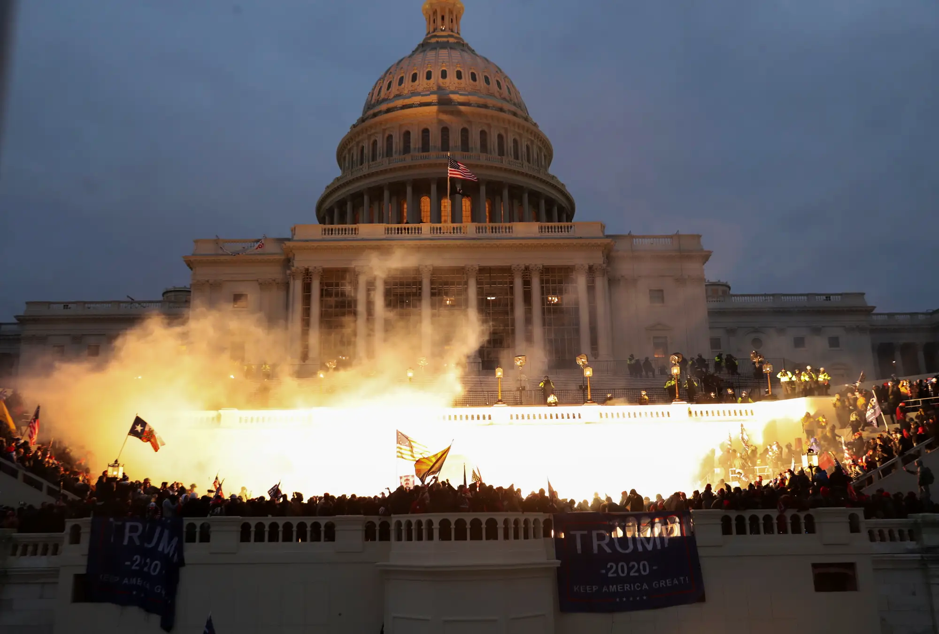
Political Polarization
“America is becoming Increasingly Polarized”
Jan 6, 2021
REUTERS/Leah Millis

Slide 3
Defining Polarization
What do we mean by polarization?
People’s views becoming more extreme?
People only associating with like-minded others? (echo chambers)
People conforming to a set of opinions? (issue alignment)

Slide 4
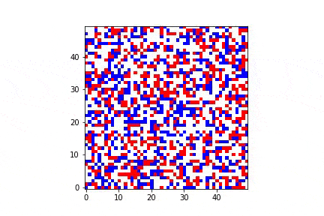
Agent-Based Modeling
-Autonomous decision-making entities (called agents)
-Agents in a physical or abstract environment
-behavioral rules of agents produce large-scale phenomena
Schelling Segregation Model

Slide 5
Modeling Polarization with an ABM
My Model:
-N heterogeneous agents
-Multiple Issues with agent opinions ranging from [0, 1]
-agents interact and influence each other’s opinions
-social network: randomly generated connected graph with undirected edges

Slide 6

Agents in the Model
Agent attributes
uniqueID: 007
Opinions: [0.24, 0.03, 0.40]
Agent 007

Slide 7
Social Network with 8 Agents

Slide 8
Influence Mechanisms
Same-Issue Influence (I2)
-inspired by principle of homophily
-agents similar/dissimilar in opinion on issue X are attracted/repelled on issue X
Cross-Issue Influence (CI2)
-inspired by principle of homophily
-agents similar/dissimilar in opinion on issue X are attracted/repelled on issue Y

Slide 9


No Influence (I2)
Issue X
0
1
Openness Threshold

Slide 10
Positive Influence (I2)
Issue X
0
1
Openness Threshold

Slide 11
Negative Influence (I2)
Issue X
0
1
Openness Threshold
Disgust Threshold

Slide 12
Positive Influence (CI2)
Issue X
0
1
Openness Threshold
Issue Y
0
1

Slide 13
Negative Influence (CI2)
Issue X
0
1
Openness Threshold
Disgust Threshold
Issue Y
0
1

Slide 14
Results
Polarization Proxy: Buckets (issue alignment)
Buckets and I2 vs. Buckets and CI2

Slide 15
Proxy: Buckets (issue alignment)
Issue Alignment: the tendency for people who agree on one issue to also agree on other (unrelated) issues
Anti-Guns
Raise Minimum Wage
Pro-Choice
Higher Taxes and Social Services
Pro-Immigration
Pro-Vaccine-Mandate
…
Pro-Guns
Lower Minimum Wage
Pro-Life
Lower Taxes and Social Services
Anti-Immigration
Anti-Vaccine-Mandate
…

Slide 16
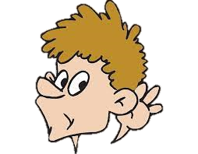
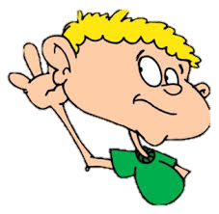
Why does Issue Alignment occur?
One Possible Explanation: A small number of media outlets broadcast a certain set of opinions on the various issues.
News source 1:
“Opinion A”!
“Opinion B”!
“Opinion C”!
…
News source 2:
“Opinion D”!
“Opinion E”!
“Opinion F”!
…

Slide 17
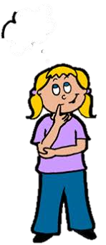
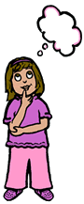
Why does Issue Alignment occur?
Another Possible Explanation: perhaps there is some deep underlying principle to people’s value systems that connects seemingly unconnected issues.
Value system =>
“Opinion A”!
“Opinion B”!
“Opinion C”!
…
Value System=>
“Opinion D”!
“Opinion E”!
“Opinion F”!
…

Slide 18
Why does Issue Alignment occur?
My model demonstrates that neither media influence nor ideological coherence is necessary for Issue Alignment to develop in a society. Cross-Issue Influence (CI2) is sufficient.
This may have wide-reaching implications on how we interpret the causes of the polarization phenomenon, and what societal changes might be necessary to reduce it.

Slide 19
Quantifying Issue Alignment
To measure the degree of issue alignment in a virtual society, I measure the number of distinct opinion buckets that exist.
A “bucket” is a specific set of numerical opinions on the various issues.
For example, “Issue 1: 0.4, Issue 2: 1.0, Issue 3: 1.0”
At any point in time, each agent is only in one bucket.
All agents in the same bucket agree on all the issues, within a threshold of ε (.05).

Slide 20
Buckets Example
Agent A:
Opinion on Issue 1: 0.4
Opinion on Issue 2: 1.0
Opinion on Issue 3: 1.0
Agent B:
Opinion on Issue 1: 0.2
Opinion on Issue 2: 0.5
Opinion on Issue 3: 0.9
Agent C:
Opinion on Issue 1: 0.3
Opinion on Issue 2: 0.6
Opinion on Issue 3: 0.1
Agent D:
Opinion on Issue 1: 0.4
Opinion on Issue 2: 1.0
Opinion on Issue 3: 1.0

Slide 21
Buckets Example
Agent A:
Opinion on Issue 1: 0.4
Opinion on Issue 2: 1.0
Opinion on Issue 3: 1.0
Agent B:
Opinion on Issue 1: 0.2
Opinion on Issue 2: 0.5
Opinion on Issue 3: 0.9
Agent C:
Opinion on Issue 1: 0.3
Opinion on Issue 2: 0.6
Opinion on Issue 3: 0.1
Agent D:
Opinion on Issue 1: 0.4
Opinion on Issue 2: 1.0
Opinion on Issue 3: 1.0
In this model, there are three buckets: one with agents A & D, one with agent B only, and one with Agent C only.

Slide 22
Interpretation
I interpret fewer buckets to mean fewer diverse viewpoints and higher polarization.
Other Terminology:
If a pair of agents agrees on every issue (i.e., they’re in the same bucket), I call them clones (or a “clone pair”).
If a pair of agents disagrees on every issue, I call them anti-clones (or an “anti-clone pair”).
Same-Issue Influence = I2
Cross-Issue Influence = CI2

Slide 23
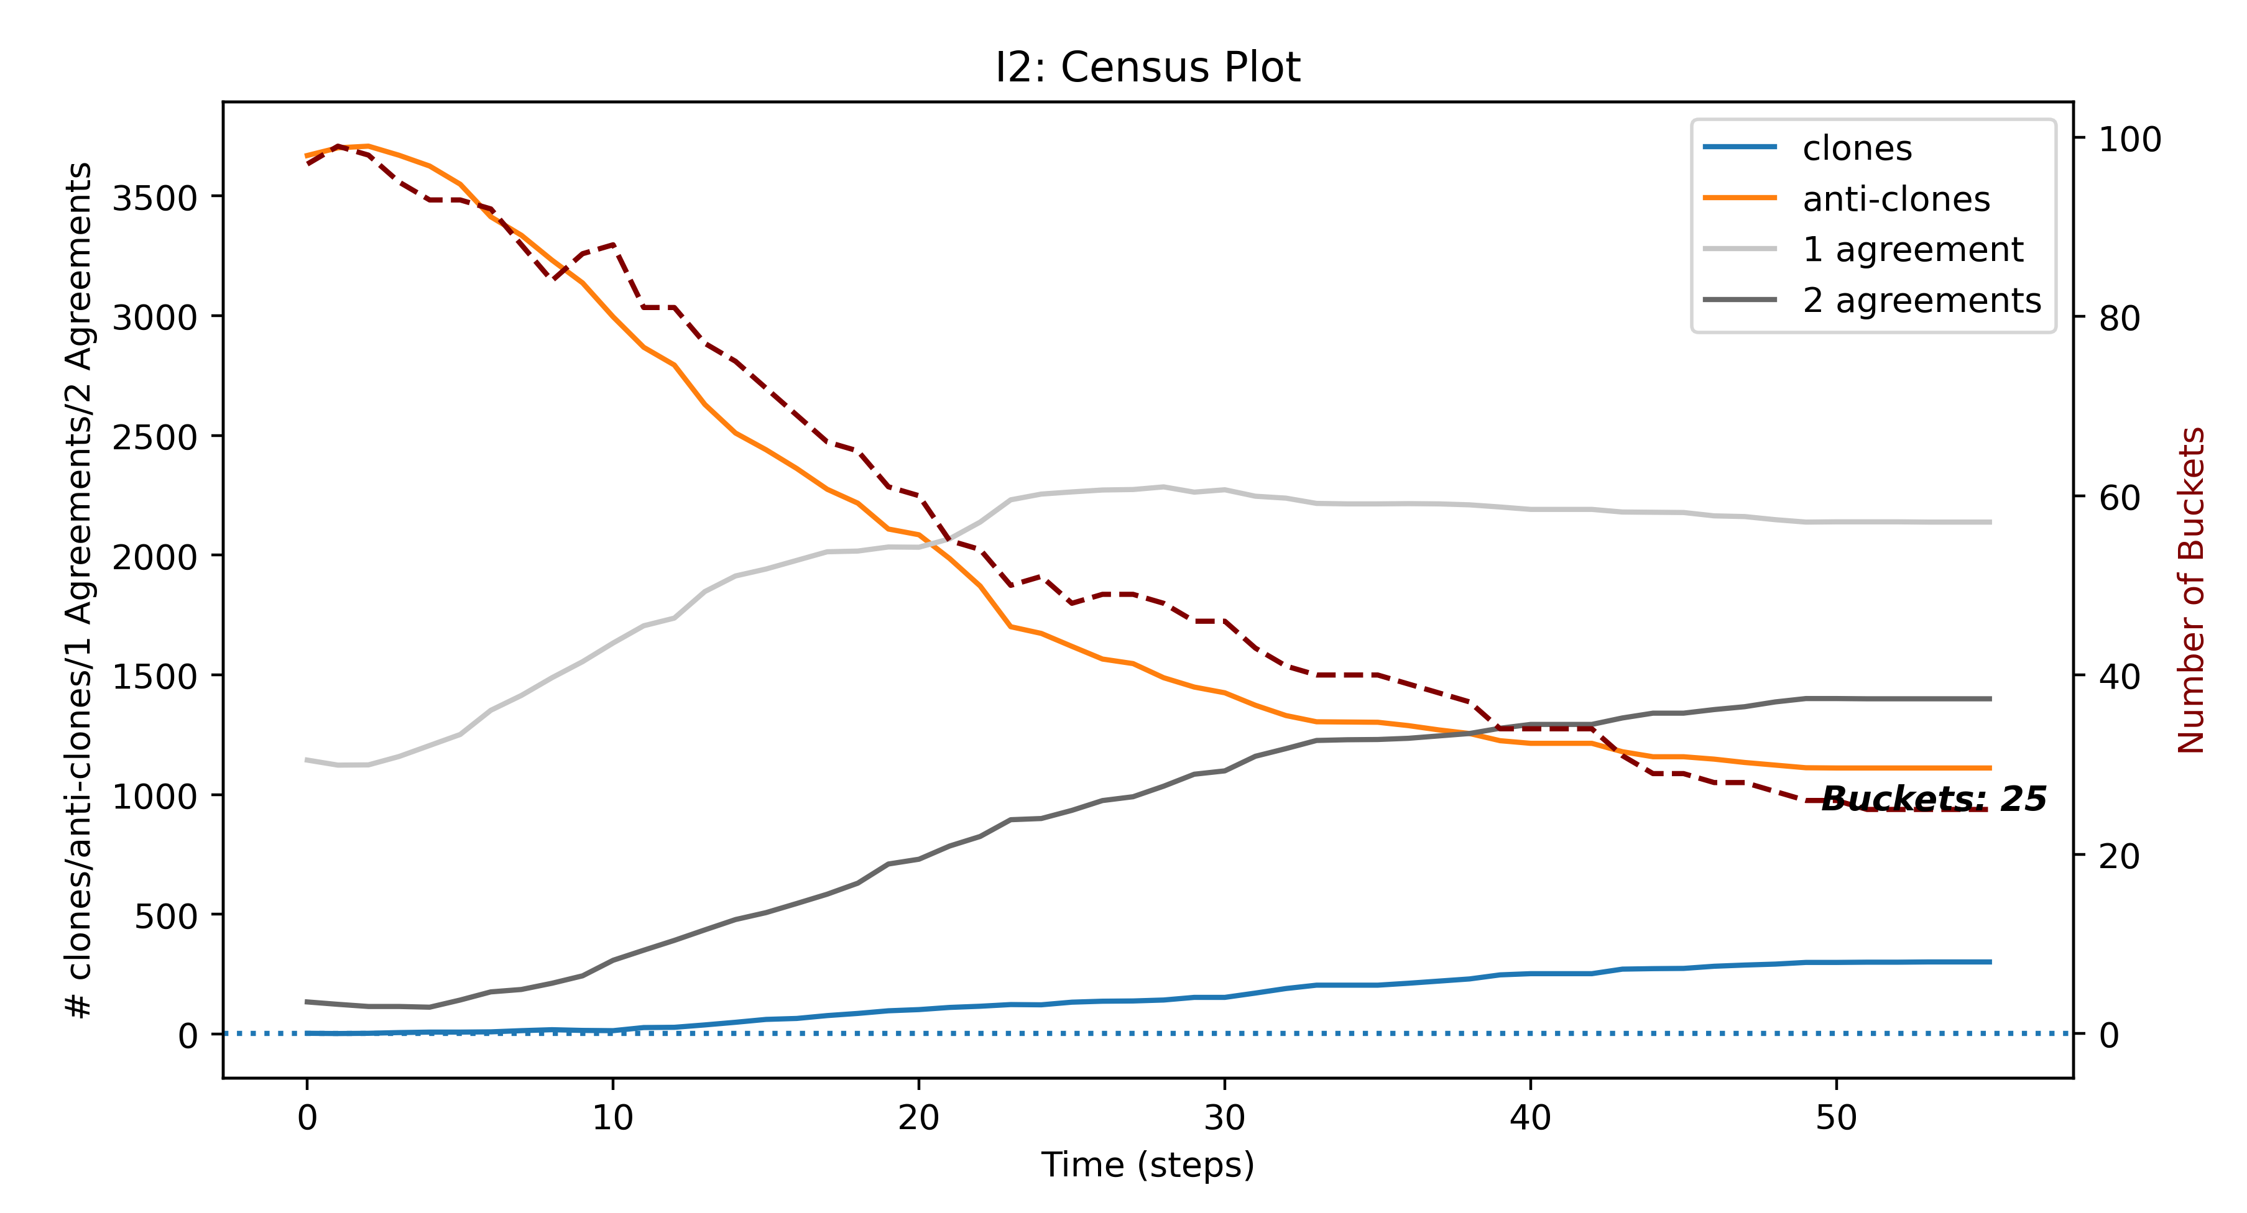
Buckets and I2

Slide 24
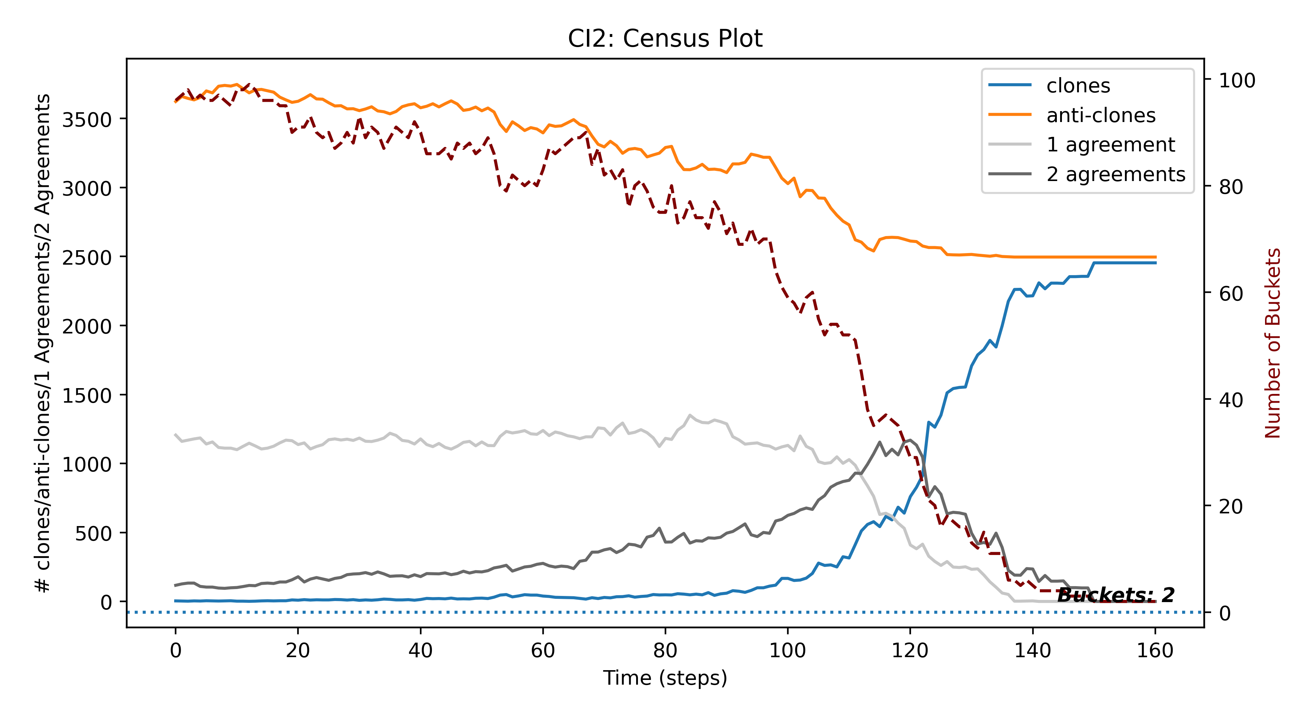
Buckets and CI2

Slide 25
Takeaways
Issue Alignment endogenously appears with CI2. We can’t solely blame media outlets or ideologies.
Individual Fix: Allow yourself the freedom to agree with someone on one thing and disagree with them on something else.
Society Fix: Parties and Media outlets undoubtedly reinforce the IA phenomenon. We need voices from more buckets.

Slide 26
Thank you for listening! Questions?
If you found the presentation interesting and want to know more:
Code: https://github.com/jmittere/DepHonors
Email: jmittere@umw.edu
Full Paper will be available as of 12/10/2021 on the Github repo

Slide 27
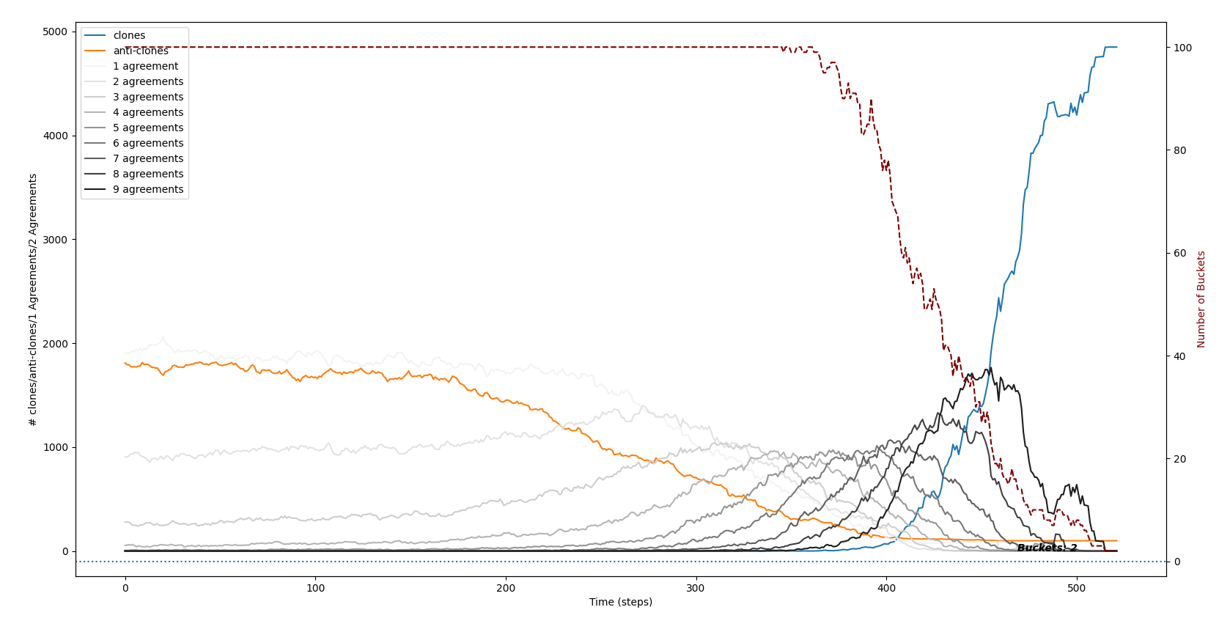
Buckets and CI2 (10 Issues)

Slide 28
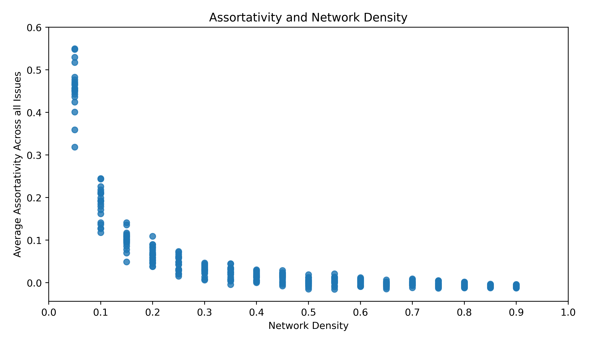
Assortativity and Network Density
Fewer meaningful social connections (lower densities) = Higher Assortativity (on the low end)

Slide 29
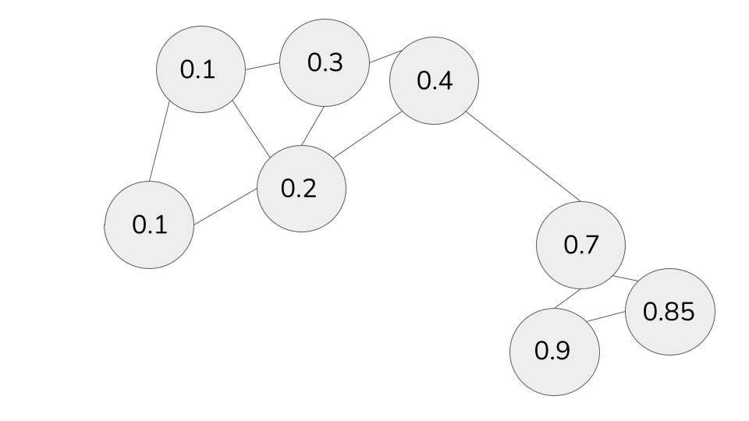

Proxy 1: Assortativity (echo chambers)
Assortativity: the tendency to associate with like-minded agents
High Assortativity
Low Assortativity

Slide 30
Results
Polarization Proxy 1: Assortativity (echo chambers)
Assortativity and Network Density
Polarization Proxy 2: Buckets (issue alignment)
Buckets and I2 vs. Buckets and CI2

Slide 31
Takeaways
Lower network density leads to higher polarization. Takeaway: people need to get out more.
Issue Alignment endogenously appears with CI2. We can’t solely blame media outlets or ideologies.
Individual Fix: Allow yourself the freedom to agree with someone on one thing and disagree with them on something else.
Society Fix: Parties and Media outlets undoubtedly reinforce the IA phenomenon. We need voices from more buckets.

